Slide 1

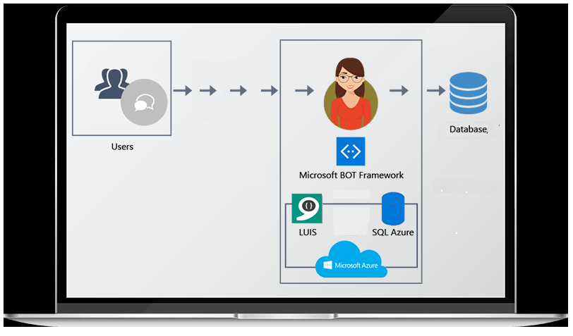
UDAAN 2020 BIETC BGS Digital Hackathon Idea Submission
TAAMBOT
Submitter(s):Sreejith U, Girish K, Surender GA
Problem Description / Personas Served / Opportunity:
TAAM Customer support currently handled via JIRA, email.
Value Proposition:
Responses for frequently asked questions about product, feature, from customers can be automated
Some obvious questions can be answered at ease, which may consume some time which can be avoided.
Reduces burden on support, Offer 24*7 Support
Idea Description:
Develop a BOT for TAAM. Provide intelligence to it about some FAQ, sending email alerts.
Provide access to JIRA, so that it can run a query through it and provide valuable info.
Equip with frequent phrases, frequent questions and develop engine
Add natural language processing ability.
Hackthon Accomplishment and Way forward :
Developed a sample application for some standard input questions.
As next step develop it on a good bot Framework
Provide the input processing abilities and equip bot with addressing real user issues.

